Slide 1
System Level Programming
Software College of SCU
Instructor: Shu, Li
Week03

Slide 2
Unit 3. Representation of Code
3.0 Brief Introduction : SLP 1.5
3.1 X86 Instructions : CSAPP Chapter 3(GCC) & intel microprocess
3.2 x86 Assembly Language Programming
3.3 Disassembly in VC++ 6.0 IDE

Slide 3
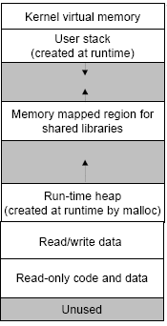
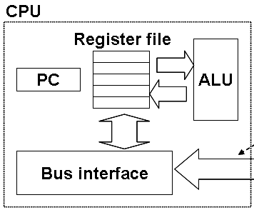
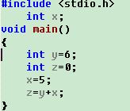
3.0 Brief Introduction (1/15)
A micro view
3.How does CPU execute machine instruction?
1.How to translate assembly code into machine code?
2.How to allocate memory?

Slide 4
3.0 Brief Introduction (2/15)
Questions
  What a CPU can and can not understand
    Can not: "c = (a + b) * d"
    Can: "Add the contents of these two registers together and put the result in the first one."
  How to encode high level language instructions to machine instructions?

Slide 5
3.0 Brief Introduction (3/15)
You will learn:
  Assembly language Review
  C statements VS Assembly language instructions
Why learn it?
  Optimizing program performance
    After you know better about how program works on CPU
  Understanding C from low level

Slide 6
3.0 Brief Introduction (4/15)
Q1: One way to inspect the machine code
#include <stdio.h>
int x;
void main()
{
int y=6; int z=0; unsigned char *cptr; int i;
x=5;
z=y+x;
cptr = ((unsigned char *) 0x0040D746); // address of instruction ”x=5”
for (i = 0; i < 10; i++) { // 0x0040D750-0x0040D746 = 10(decimal)
printf("%02X ", *cptr);
cptr++;
} //one way to inspect machine code
printf("\n");
}

Slide 7
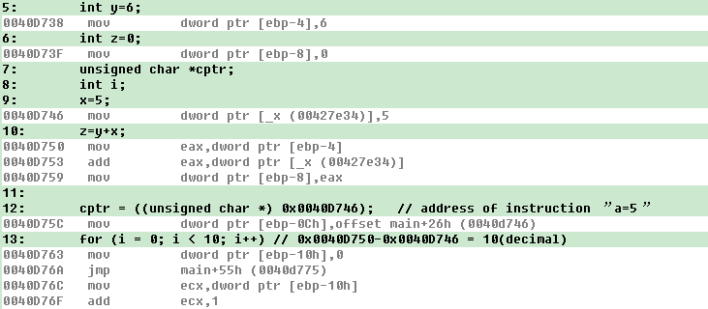
3.0 Brief Introduction (5/15)
The code and data are stored in memory separately.
  Code(cs+ip): mov eax,dword ptr[ebp-4]
  Data(stack+ebp): in stack, accessed via [ebp-4]
To show this window:
View->Debug Windows->Disassembly

Slide 8
3.0 Brief Introduction (6/15)
Instruction
  CPU related
  Opcode：操作码
    The operations/Opcode/操作码 that the CPU can support
  Operand：操作数/操作数的地址
    Also define the method in which Operand are accessed(访问操作数的模式,register /mem/imm)
Opcode Operand

Slide 9

3.0 Brief Introduction (7/15)
0040D746 mov dword ptr [_x (00427e34)],5
The opcode instructs the CPU to move the four-byte literal in the last 4 bytes to the address followed the opcode.
  Immediate Data “5” stored in instruction code directly.
  Global data “x” stored in a certain section of memory.
Opcode
Operand 1 (&x)
Operand 2 (imm 5)

Slide 10
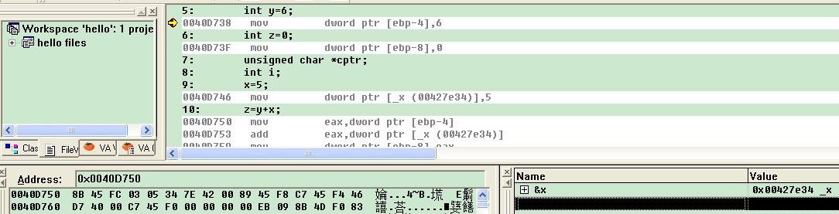
3.0 Brief Introduction (8/15)
Another way to inspect the machine code
  Using memory window

Slide 11
3.0 Brief Introduction (9/15)
The layout for a machine instruction opcode
Dest:1 bit. A 1 indicates the the register operand is the destination
Mod:2 bits. Indicates what the second operand is.
For instance: 00 direct or indirect memory reference
15 11 10 9 8 7 6 5 4 3 2 1 0
1
0
0
0
1
0
D
W
MOD
REG
R/M
OP:6 bits. Indicates the operation being performed
W:1 bit. A 1 indicated that the operation is on words
Reg:3 bits. indicates which register is being used
R/M:3 bits. used with MOD to indicate what the second operand is, R/M stands for register or memory

Slide 12
3.0 Brief Introduction (10/15)
This instruction will load x into eax.
  0040D750 mov eax, dword ptr [ebp-4]
  Classical encode format of mov instruction
15 11 10 9 8 7 6 5 4 3 2 1 0
1
0
0
0
1
0
D
W
MOD
REG
R/M
displacement
op
8B
45
FC
1 | 0 | 0 | 0 | 1 | 0 | 1 | 1 | 01 | 000 | 110
1111 | 1100
Displacement-4

Slide 13
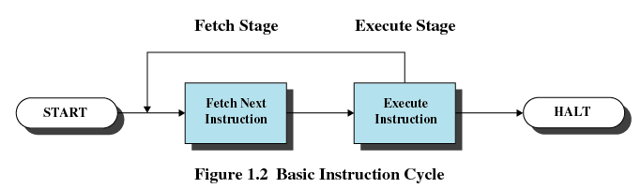
3.0 Brief Introduction (11/15)
Two stages of each Instruction Execution
  CPU executes instructions one by one

Slide 14
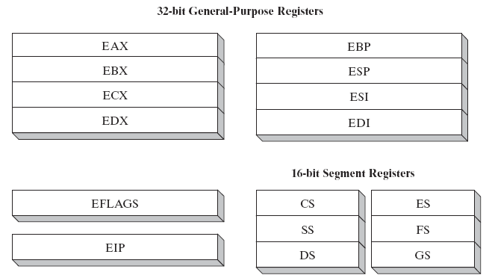
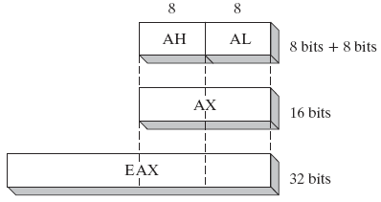
3.0 Brief Introduction (12/15)
8086 Register/ Real Mode
In real mode

Slide 15
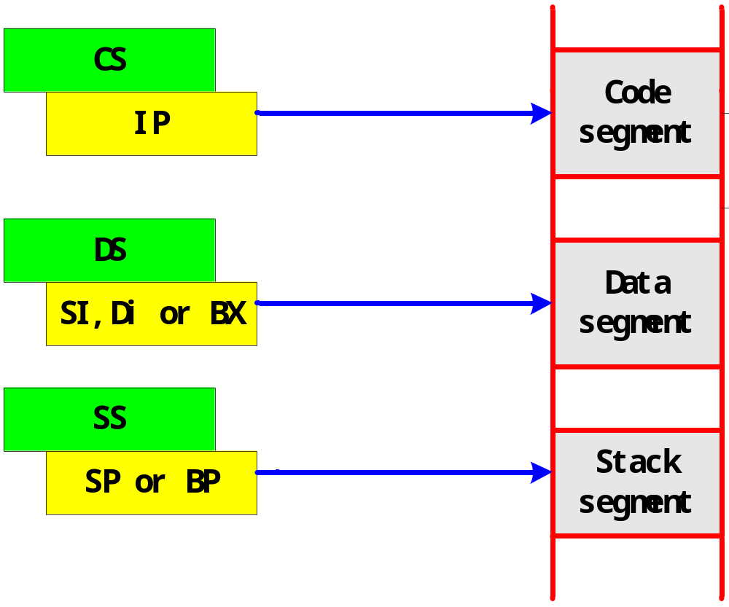
3.0 Brief Introduction (13/15)
Segment register
ES
Extra segment

Slide 16
3.0 Brief Introduction (14/15)
How the EIP is changed：
  automatically increment
  jump instructions：change the program counter
  branch instructions：change the program counter conditionally, according to PSW (program status word) Register (== FR, Flag Register )

Slide 17
3.0 Brief Introduction (15/15)
Summary of brief introduction
  C to ASM
    Code in ASM
  ASM to Machine code
    Machine code executed by CPU

Slide 18
Unit 3. Representation of Code
3.0 Brief Introduction
3.1 x86 Instructions
3.2 x86 Assembly Language Programming
3.3 Disassembly in VC++ 6.0 IDE

Slide 19
3.1.2 8086 Instructions
3.1.1 Operand-addressing Mode
3.1.2 Instruction Set

Slide 20
3.1.1 Operand-addressing Mode (1/8)
Operand Addressing：
  What determines which data item will be fetched at each step of a instruction's execution?
    In c : use a variable
    In machine code : operand-addressing mode
Operand-addressing Mode Classified
  Register
  Immediate
  Memory

Slide 21
3.1.1 Operand-addressing Mode (2/8)
Data-addressing Mode Classified in X86
  Register (寄存器寻址)
  Immediate(立即寻址)
  Memory(存储器寻址)
    direct addressing (直接寻址)
    register indirect addressing(寄存器间接寻址)
    base-plus-index addressing(基址加变址寻址)
    Register relative Addressing(寄存器相对寻址方式)
    base relative-plus-index addressing(相对基址变址寻址)
    scaled-index addressing(比例变址寻址)
  I/O寻址

Slide 22
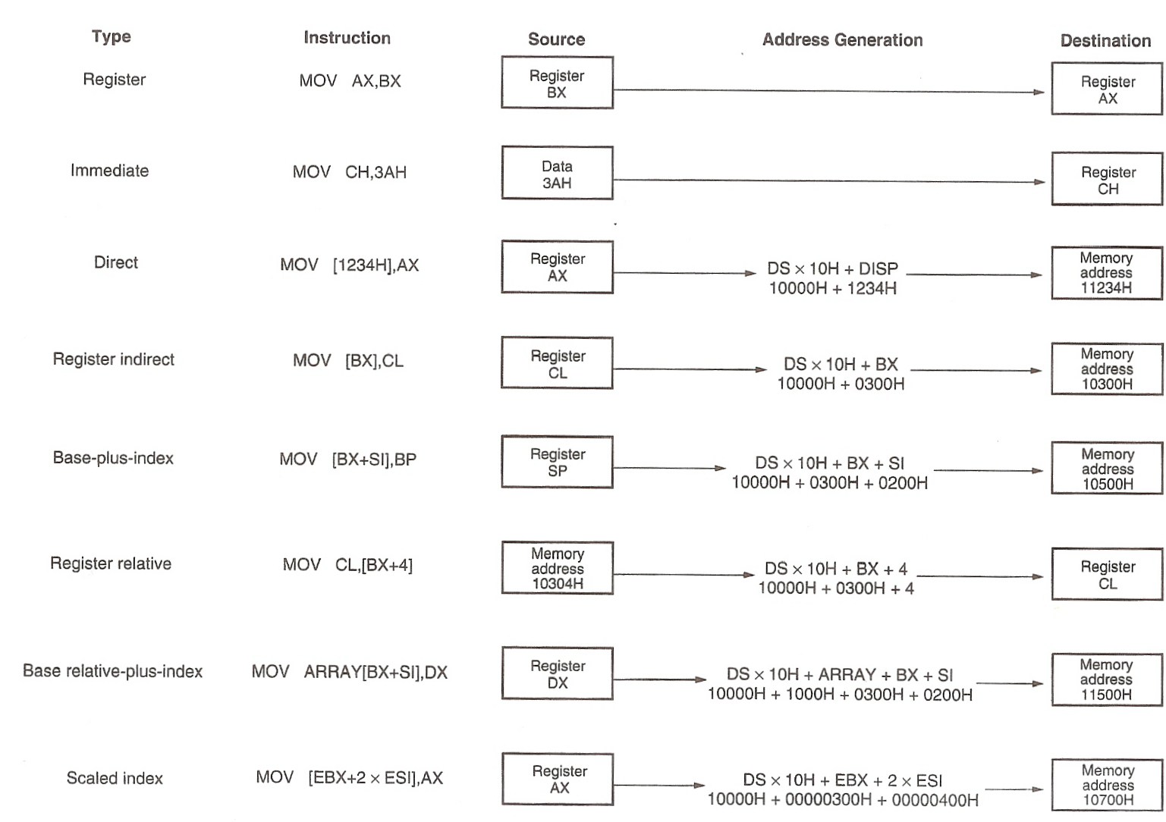
3.1.1 Operand-addressing Mode (3/8)

Slide 23

3.1.1 Operand-addressing Mode (4/8)
Register Addressing
  All operands are stored in general purpose registers.
    16 bits :AX，BX，CX，DX，SI，DL，SP or BP；
    8 bits: AH，AL，BH，BL，CH，CL，DH or DL。
  MOV AX，BX ；copy data from BX to AX

Slide 24
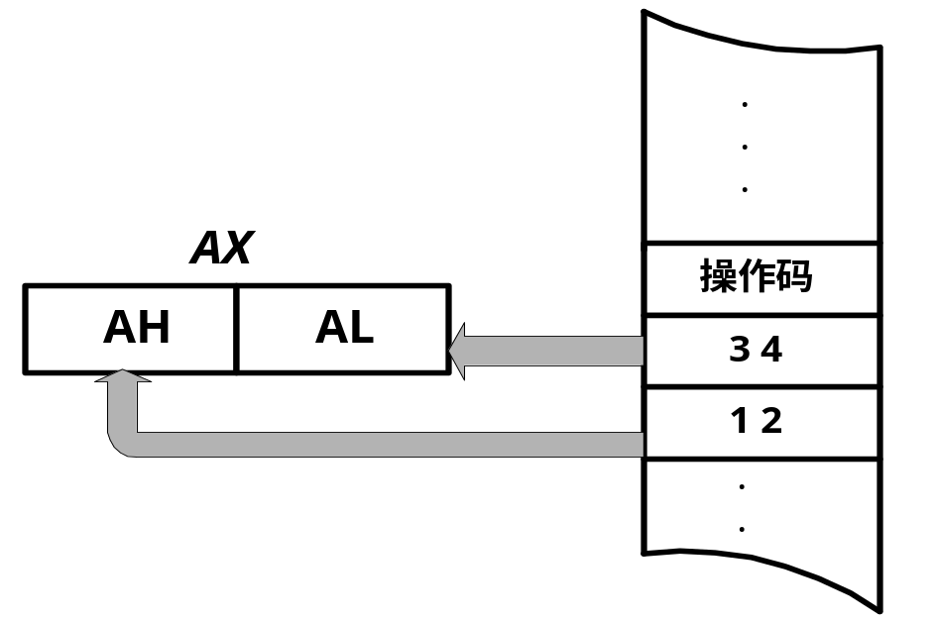
3.1.1 Operand-addressing Mode (5/8)
Immediate addressing
  MOV AX，1234H
Code section

Slide 25
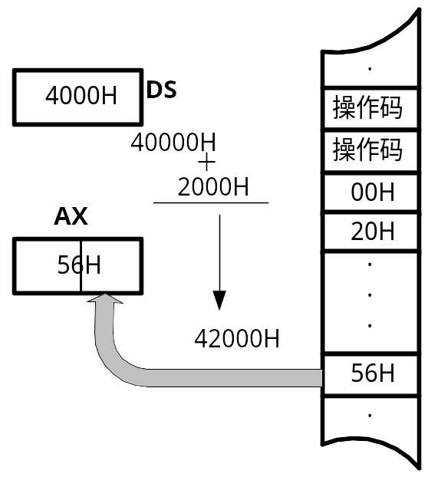
3.1.1 Operand-addressing Mode (6/8)
Direct Memory Addressing
  MOV AL，DS:[2000H] ；
  1. linear address = DS shifts towards left for 4 bits + offset
  2. One byte data in that address will be copy to AL

Slide 26
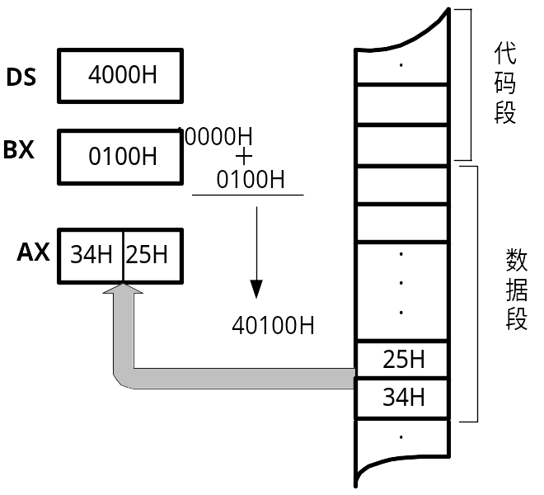
3.1.1 Operand-addressing Mode (7/8)
Register Indirect addressing
  MOV AX，[BX] ；
  linear address = DS shifts towards left for 4 bits + effective address in BX

Slide 27
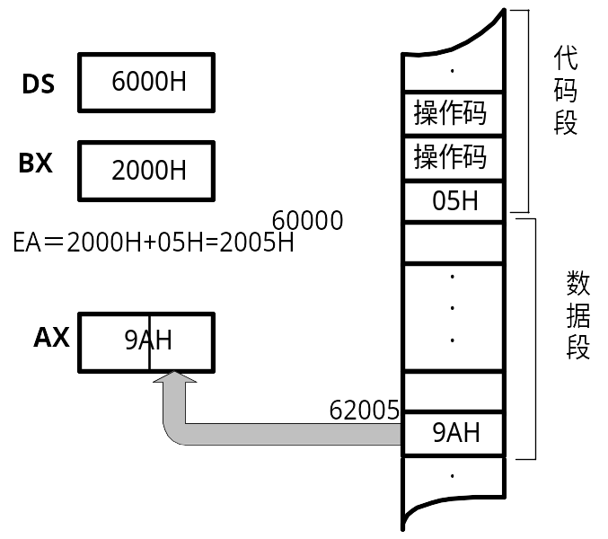
3.1.1 Operand-addressing Mode (8/8)
register relative addressing
  MOV AL，[BX+5]
  linear address = DS shifts towards left for 4 bits + BX+5

Slide 28
3.1 X86 Instructions
3.1 8086 Instructions
  3.1.1 Operand-addressing Mode
  3.1.2 Instruction Set

Slide 29
3.1.2 Instruction Set(1/12)
8086 Instruction Set: classified according to their functions
  1) Data transforming/数据传送类
  2) Arithmetic operation/算术运算类
  3) Bits and logic operation/位与逻辑运算类
  4) String operation/字符串处理类
  5) Branch and loop/控制转移类
  6) CPU control/处理器控制类

Slide 30
3.1.2 Instruction Set(2/12)
8086 Instruction Set: Description about an instruction
  A. Function:指令的基本功能
  B. Affection: how do the instruction affect the Flag Register/ PSW
  C. Data-addressing mode:
  D. Limitation: which register can or can’t be used

Slide 31
3.1.2 Instruction Set(3/12)
1) Data transforming/数据传送类
  MOV (Move )
  PUSH (Push data onto stack ), POP (Pop data from stack )
    PUSH AX POP BX
  XCHG (Exchange data )
  XLAT (Table look-up translation)
  LEA (Load Effective Address )
  LDS (Load pointer using DS ),LES (Load ES with pointer )
  LAHF (Load flags into AH register ), SAHF (Store AH into flags )
  PUSHF (Push flags onto stack ), POPF (Pop data into flags register )
  IN (Input from port ), OUT (Output to port )

Slide 32
3.1.2 Instruction Set(4/12)
2) Arithmetic operation/算术运算类
  ADD (Add), ADC (Add with carry), INC (Increment by 1)
  SUB (Subtraction ), SBB (Subtraction with borrow ), DEC (Decrement by 1 ), NEG (Two's complement negation)
  CMP (Compare operands )
  MUL (Unsigned multiply ), IMUL (Signed multiply )
  DIV (Unsigned divide), IDIV (Signed divide )
  CBW (Convert byte to word), CWD (Convert word to doubleword )
  DAA (Decimal adjust AL after addition ), DAS (Decimal adjust AL after subtraction), AAA (ASCII adjust AL after addition), AAS (ASCII adjust AL after subtraction), AAM (ASCII adjust AX after multiplication), AAD (ASCII adjust AX before division)
    used with unpacked binary-coded decimal

Slide 33

3.1.2 Instruction Set(5/12)
3) Bits and logic operation/位与逻辑运算类
  NOT, AND, OR, XOR,
  TEST (Logical compare (AND) )
  SHL, SHR
  SAL, SAR
  ROL (Rotate left ), ROR (Rotate right )
  RCL (Rotate through carray left), RCR (Rotate through carry right )

Slide 34
3.1.2 Instruction Set(6/12)
4) String operation/字符串处理类
  MOVSB (Move byte from string to string)
  STOSB (Store byte in string ), LODSB (Load byte)
  CMPSB (Compare bytes in memory)
  SCASB (Compare byte string)
    Prefix: REPxx (Repeat CMPS/MOVS/SCAS/STOS )/REPZ

Slide 35
3.1.2 Instruction Set(7/12)
0040D729 lea edi,[ebp-50h];edi = ebp-50h
0040D72C mov ecx,14h;loop counter
0040D731 mov eax,0CCCCCCCCh;tag
0040D736 rep stos dword ptr [edi]
; write the value of eax to memory location addressed by edi for ecx times, edi automatically increases 4 in each iteration.

Slide 36
3.1.2 Instruction Set(8/12)
5) Branch and loop/控制转移类
  JMP (Jump)
  Jxx (Jump if condition)/JE,JNE; JS,JNS; JO,JNO; JC,JNC; JP,JNP;JB,JNB; JA,JNA (unsigned); JG,JNG,JL,JNL (signed)
  LOOP, LOOPx (Loop control)/LOOPZ,LOOPNZ,JCXZ
  CALL (Call procedure),RET (Return from procedure )
  INT (Call DOS interrupt), IRET (Return from interrupt )

Slide 37
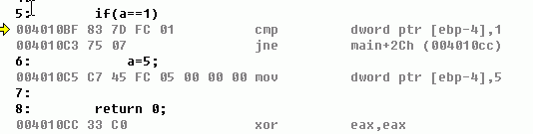
3.1.2 Instruction Set(9/12)
Branch Instructions Example
if (a == 1) {
a = 5;
}
CMP subtracts the second operand from the first but, unlike the SUB instruction, does not store the result; only the flags are changed.
JNE Jump if not equal. Test ZF=0.

Slide 38
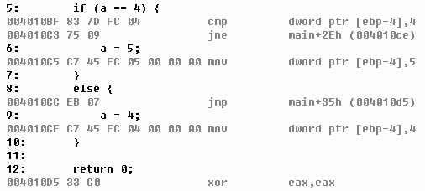
3.1.2 Instruction Set(10/12)
if (a == 4) { a = 5; } else { a = 4; }
Jump Instruction
EIP 004010CC
EIP 004010D5

Slide 39
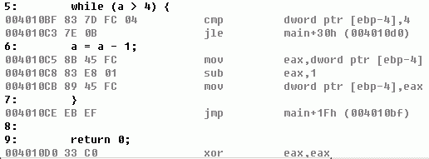
3.1.2 Instruction Set(11/12)
Loops are constructed by compilers in terms of jumps and branches
while (a > 4) { a = a - 1; }

Slide 40
3.1.2 Instruction Set(12/12)
6) CPU control/处理器控制类
  CLC (Clear carry flag), STC (Set carry flag), CMC (Complement carry flag)
  CLD( Clear direction flag ),STD (Set direction flag )
  CLI (Clear interrupt flag ),STI (Set interrupt flag )
  NOP (No operation )
  HLT (Enter halt state)
    halts the CPU until the next external interrupt is fired.
  WAIT (Wait until not busy )
  LOCK (Assert BUS LOCK# signal ) (for multiprocessing)
  ESC (Escape)

Slide 41
Unit 3. Representation of Code
3.0 Intro
3.1 X86 Instructions
3.2 x86 Assembly Language Programming
3.3 Disassembly in VC++ 6.0 IDE

Slide 42
3.2 x86 Assembly Language Programming
3.2.1 Assembly Language Introduce
3.2.2 8086 Assembly Language

Slide 43
3.2.1 Assembly Language Introduce(1/2)
Assembly Language : CPU related
  The set of mnemonics/助记符 accepted by an assembler for a specific CPU type became known as the assembly language for that CPU type

Slide 44
3.2.1 Assembly Language Introduce(2/2)
Assembler VS Compiler
  Similar:
    translate one "language" into another
  Dissimilar:
    analyzing meaning or not
    having choice or not
    See CSAPP 3.6.6

Slide 45
3.2 x86 Assembly Language Programming
3.2.1 Assembly Language Introduce
3.2.2 8086 Assembly Language

Slide 46
3.2.2 8086 Assembly Language(1/11)
Two styles of assembly language
  GAS(GNU Assembly)/AT&T
    The one on the CSAPP book
  Intel/MASM
    The one that we use on VC ++ IDE
    Microsoft Macro Assembler (MASM) is an x86 assembler that uses the Intel syntax.

Slide 47
3.2.2 8086 Assembly Language(2/11)
Types of Statements in Assembly Language
  1. Executable Instructions (可执行指令 )
    Generate machine code for the processor to execute at runtime
    Instructions tell the processor what to do
  2. Macros (宏指令)
    Translated by the assembler into real instructions
    Simplify the programmer task
  3. Assembler Directives (伪指令 )
    Provide information to the assembler while translating a program
    Used to define segments, allocate memory variables, etc.
    Non-executable: directives are not part of the instruction set

Slide 48
3.2.2 8086 Assembly Language(3/11)
Example: Adding and Subtracting Integers
TITLE Add and Subtract (AddSub.asm)
; This program adds and subtracts 32-bit integers.
.686
.MODEL FLAT, STDCALL//stdcall为API调用时右边的参数先入栈
.STACK
INCLUDE Irvine32.inc
.DATA
.CODE
main PROC
mov eax,10000h ; EAX = 10000h
add eax,40000h ; EAX = 50000h
sub eax,20000h ; EAX = 30000h
call DumpRegs ; display registers
  exit ; macro defined in Irvine32.inc
main ENDP
END main

Slide 49
3.2.2 8086 Assembly Language(4/11)
Procedure DumpRegs is defined in Irvine32.lib library
It produces the following console output,
showing registers and flags:
EAX=00030000 EBX=7FFDF000 ECX=00000101 EDX=FFFFFFFF
ESI=00000000 EDI=00000000 EBP=0012FFF0 ESP=0012FFC4
EIP=00401024 EFL=00000206 CF=0 SF=0 ZF=0 OF=0

Slide 50
3.2.2 8086 Assembly Language(5/11)
Editor
  Write new (.asm) programs
  Make changes to existing ones
Assembler: ML.exe program
  Translate (.asm) file into object (.obj) file in machine language
  Can produce a listing (.lst) file that shows the work of assembler
Linker: LINK32.exe program
  Combine object (.obj) files with link library (.lib) files
  Produce executable (.exe) file
  Can produce optional (.map) file
Edit
prog.asm
Assemble
library.lib
prog.obj
prog.lst
Link
prog.exe
prog.map
Debug
Run

Slide 51
3.2.2 8086 Assembly Language(6/11)
Listing File :Use it to see how your program is assembled
Contains
  Source code
  Object code
  Relative addresses
  Segment names
  Symbols
    Variables
    Procedures
    Constants
Object & source code in a listing file
00000000 .code
00000000 main PROC
00000000 B8 00060000 mov eax, 60000h
00000005 05 00080000 add eax, 80000h
0000000A 2D 00020000 sub eax, 20000h
0000000F 6A 00 push 0
00000011 E8 00000000 E call ExitProcess
00000016 main ENDP
END main
Relative
Addresses
object code
(hexadecimal)
source code

Slide 52
3.2.2 8086 Assembly Language(7/11)
Map File
Start Stop Length Name Class
00000H 00010H 00011H DATA DATA
00020H 0011FH 00100H SS_SEG STACK
00120H 0012FH 00010H CODE CODE
Program entry point at 0012:0000

Slide 53
3.2.2 8086 Assembly Language(8/11)
You should learn, if you want to master Assembly Language
  Instruction Set, as well as data-addressing mode
  Pseudo-operation/directive
  Others, such as macro
  The development tools

Slide 54
3.2.2 8086 Assembly Language(9/11)
You have many choices on X86
  1) Assembler
    MASM, NASM,TASM, GAS etc
  2) Platform
    16 bits for DOS, 32 bits for Windows
  3) Format
    Models, full-segment

Slide 55
3.2.2 8086 Assembly Language(10/11)
Lab 3 Preview
  Practice 1: your first assembly progam
  Practice 2: develop assembly program with VC++ 6.0
  Practice 3: observe C program by VC++ disassembly
  Practice 4: program a simple x86 BootLoader

Slide 56
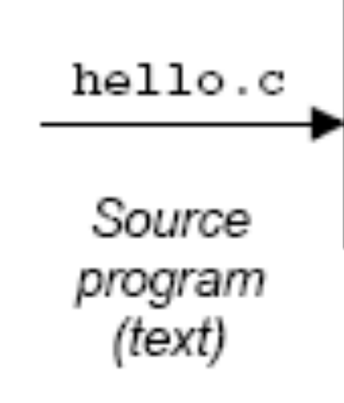


3.2.2 8086 Assembly Language(11/11)
In this course, we will not focus on Assembly Language programming
  We will pay more attention to Disassembly/反汇编

Slide 57
Unit 3. Representation of Code
3.0 Brief Introduction
3.1 X86 Instructions
3.2 x86 Assembly Language Programming
3.3 Disassembly in VC++ 6.0 IDE

Slide 58
3.3 Disassembly in VC++ 6.0 IDE(1/7)
Disassembly
  Useful tool for examining object code
  Produces approximate rendition of assembly code
  Analyzes bit pattern of series of instructions
  Can be run on either executable or .o file
    Debug and Release version

Slide 59
3.3 Disassembly in VC++ 6.0 IDE(2/7)
In VC++ 6.0, we can Disassembly in two methods
  1)By creating a Assembly file when compiling
    Setting first
  2)By using the Disassembly Windows when debugging

Slide 60
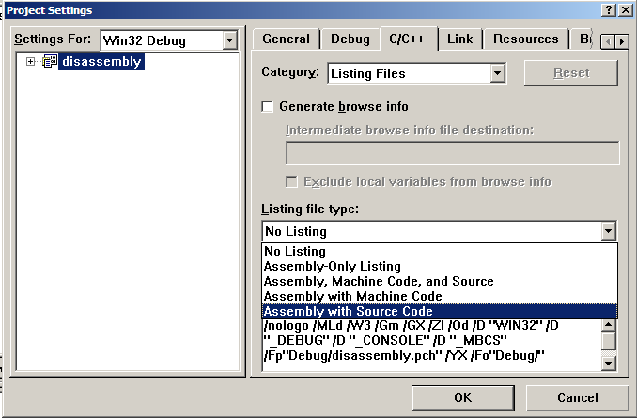
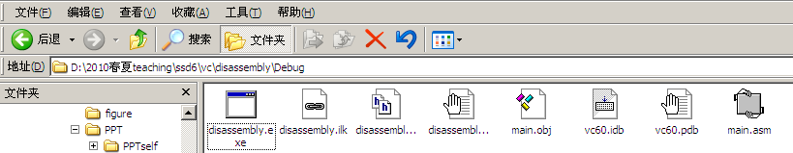
3.3 Disassembly in VC++ 6.0 IDE(3/7)
Method 1)
  output an assembly file

Slide 61
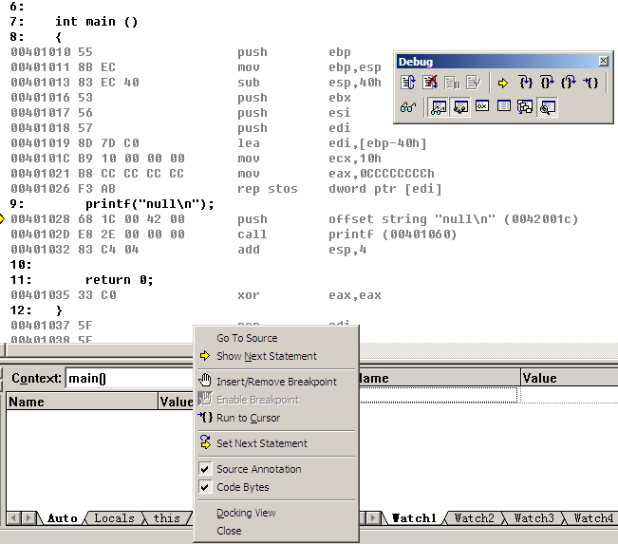
3.3 Disassembly in VC++ 6.0 IDE(4/7)
Method 2)
201001V1.1

Slide 62
3.3 Disassembly in VC++ 6.0 IDE(5/7)
Register Allocation
  The compiler would like to be able to allocate a register for every variable in the source program, because every variable that lives in a register speeds up the program's execution by some amount
  CPU has a few registers，when and how to use each register for which variable.
  Who do it
    Assembly level：programmer him/herself
    C level：Compiler

Slide 63
3.3 Disassembly in VC++ 6.0 IDE(6/7)
Optimization level
  High:
    result in more aggressive optimizations which take longer to compile
    be difficult, both for people and for debuggers, to relate the resulting machine code to the original source code
  Low: [during development ]
    result in slow execution

Slide 64
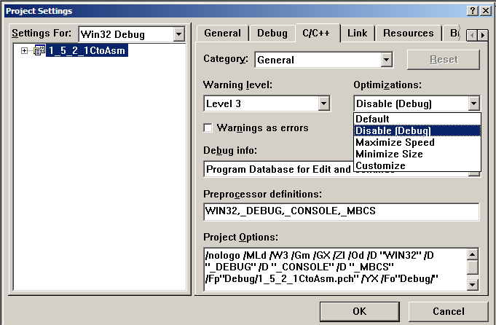
3.3 Disassembly in VC++ 6.0 IDE(7/7)
Setting
201001V1.1

